Slide 1
Module 5: Sampling
5.6: Stratified sampling
Annie Collins
Data Sciences Institute, University of Toronto

Slide 2
Learning Outcomes
How might our study be impacted if we divide our population into groups by shared characteristics before sampling? How do we effectively study a sample selected in this manner?
Identify benefits of using stratified random sampling
Compute sample statistics for stratified random samples
Design a study using stratified random sampling
Distinguish between stratified random sampling and quota sampling

Slide 3
What is stratified sampling?

Slide 4
Stratified Sampling
Divide the whole population into non-overlapping subpopulations based on shared characteristics. These subpopulations are called strata.
Take independent probability samples (often SRS) from each stratum.
Pool individual samples together to calculate overall population estimates.
Stratified sampling often requires supplemental information about a population in order to divide it into separate groups.
For example if you have a list of all student emails from a university and you want to stratify by gender, this list will need to be linked with a data source that includes each student’s gender

Slide 5
Why stratify?
Preventing a non-representative sample
Seeking estimates with known precisions for certain subpopulations
Convenience and lower cost
Higher precision (lower variance) estimates for population means and totals

Slide 6
Sample Estimates and Variability

Slide 7
Sample and Population Sizes
Suppose we have a population of size N divided into H strata. Let N_{h} be the number of population units in stratum h. Then we must have,
N₁ + N₂ + … + N_{H} = N
Suppose we then take an SRS from each stratum. Let n_{h} represent the size of the sample selected from stratum h. The total sample size is,
n₁ + n₂ + … + n_{H} = n
Sample and population sizes do not have to be equal across all strata

Slide 8
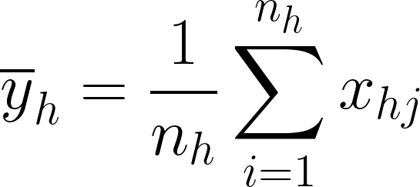
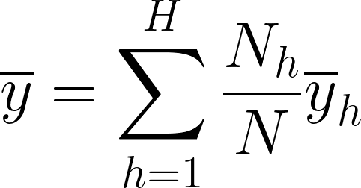
Sample Mean
The sample mean for stratum h can be calculated,
To estimate the population mean, the sample mean for the whole sample (from all strata combined) can be calculated,
This is a weighted mean of all sample strata means.

Slide 9
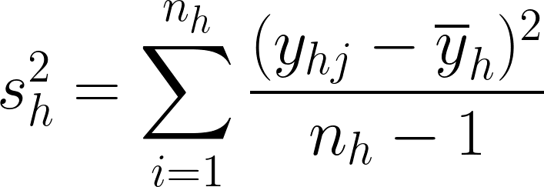
Stratum Sample Variance
The sample variance for the the sample from each stratum can be computed the same way as an SRS:

Slide 10

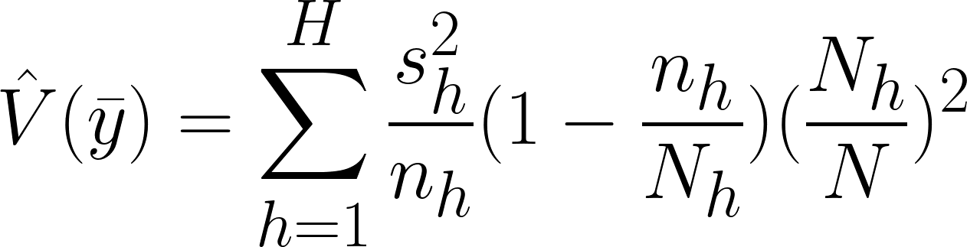
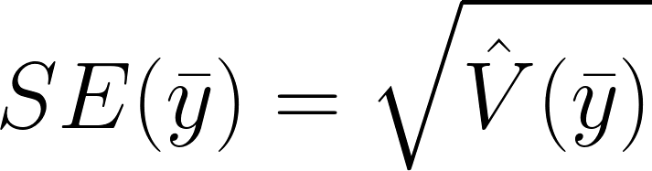
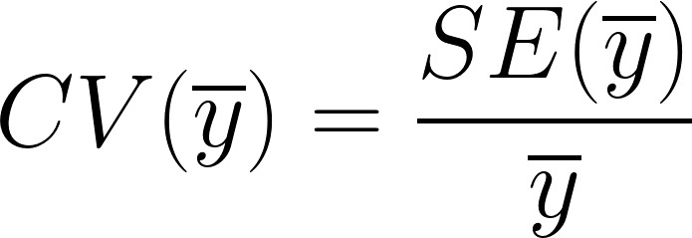
Estimator Variance and Error
The variance of the sample mean can be computed,
The standard error (SE) and coefficient of variation (CV) remain the same as for an SRS:

Slide 11
Weights

Slide 12


Weights
When using stratified sampling, weights may differ by stratum.
The inclusion probability for unit i of stratum h is,
Where n_{h} is the size of SRS from stratum h and N_{h} is the total number of units in stratum h.
As previous, the sampling weight for unit i of stratum h is then,

Slide 13
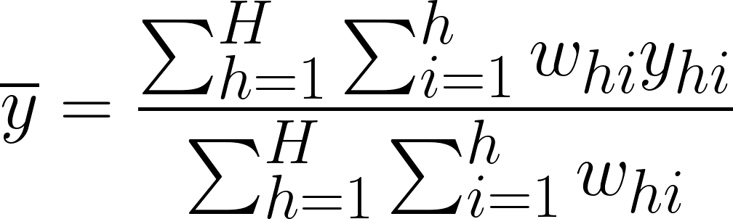
Using Sample Weights
The population mean can be estimated directly using a weighted mean of recorded observations:
In stratified sampling, we need to sum over the weights and units in each stratum, and then sum over all strata.

Slide 14
Defining Strata & Allocating Observations

Slide 15
Defining Strata
How do you divide your population into strata?
Mean values should differ greatly between strata
Stratify by a variable that is closely related to the variable(s) you are trying to estimate
For example, if you wish to estimate average height, you might stratify by age or sex instead of geographic location
Data availability
Is there existing survey data to help you define appropriate strata? If not, are you able to collect preliminary data for this purpose?
More supplementary data often means more strata
Difficulty and cost
More strata may mean a higher cost or effort involved
Is this additional cost worthwhile for the precision you wish to achieve or the type of analysis you wish to conduct?

Slide 16
Allocating Observations to Strata
How many units should you sample from each stratum?
Proportional Allocation
Sample the same proportion of units from each stratum
Sample weights (𝜋_{hi}) are the same for each sampled unit regardless of stratum
Optimal Allocation
Variation among larger sampling units may be greater than variation among smaller sampling units, so a higher proportion of large units should be sampled
Useful for businesses, cities, and institutions like schools or hospitals
Allocation for Precision with Strata
Sample to reduce the variation in stratum-level estimates, not population-level estimates
Useful when the goal is comparing estimates between strata

Slide 17
Quota Sampling

Slide 18
Quota Sampling
Population is divided into subpopulations like strata
Non-probability sampling is conducted within each subpopulation
Often convenience sampling is used
Specified amounts (quotas) of types of units are selected

Slide 19
Why use quota sampling?
Probability sampling may be expensive or impractical
May give better results than a pure convenience sample due to enforced quotas
Cheaper than probability samples
Why not use quota sampling?
Prone to selection bias
Methods of analysis for probability samples do not apply

Slide 20
Next
5.7 Cluster sampling

